Slide 1
Face Mask Detection

Slide 2
Table of Contents
01
02
03
Overview
Components
System Architecture
04
05
06
Demonstration
Conclusion
Troubleshooting Guide

Slide 3
1.Overview
The Face Mask Detection system, uses a camera to check if people wear masks. The computer looks at a video and decides if someone has a mask on. This information is sent over the Internet to a small computer chip (Arduino). The chip controls lights and sounds. If someone has a mask, it turns on a green light and plays a nice sound. If not, it turns on a red light and makes a warning sound. It's like a smart system that helps make sure people wear masks in public places.

Slide 4
2.Components
• Hardware Components:
1. Camera
2. Computer
3. Arduino Board
4. LEDs
5. Buzzer
6. Breadboard
• Software Components:
1. Python Script
2. Face Detection Model
3. Face Mask Detection Model
4. Arduino Code
• Communication Components:
1. Serial Communication

Slide 5
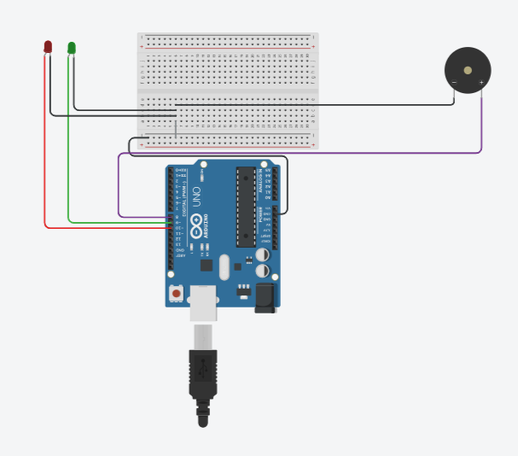
3.System Architecture
• Hardware Setup:
Connecting the Arduino board to the computer via USB.
Setting up the Arduino components.

Slide 6
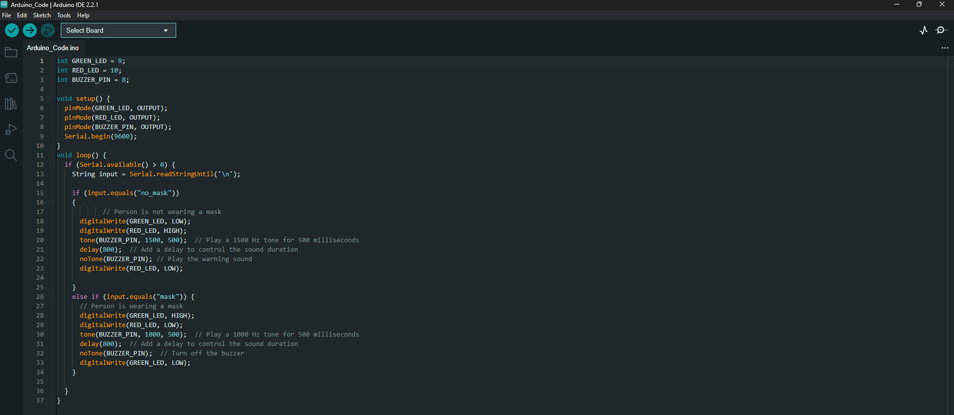
3.System Architecture (Cont.)

Slide 7
3.System Architecture (Cont.)
• Software Setup:
Set up the Python environment for computer vision, including TensorFlow, Keras, OpenCV, and imutils.
Test the face detection model separately with sample images.
Integrate the face detection model into the Python script and ensure it works with real-time video input.
Test the face mask detection model separately with sample images.
Integrate the face mask detection model into the Python script and ensure it works with detected faces.
Establish serial communication between the Python script and Arduino board.
Modify the Python script to send appropriate commands to the Arduino based on the face mask detection results.

Slide 8
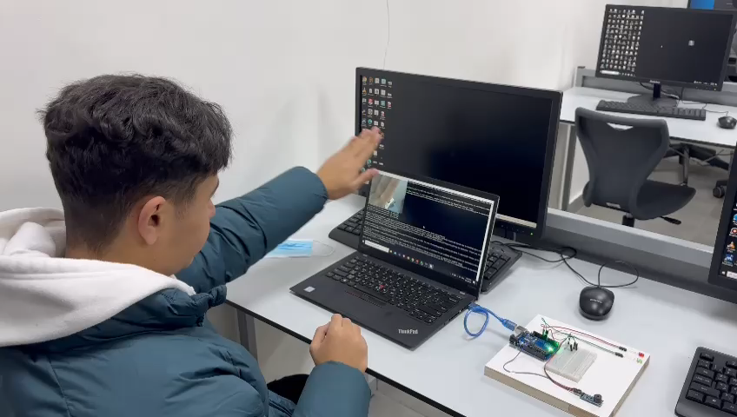
4.Demonstration

Slide 9
5.Troubleshooting Guide
• Installation and Environment:
Issue: Libraries not installed or configured.
Solution: Double-check installation steps. Ensure required libraries like OpenCV, TensorFlow, and imutils are installed. Verify Python and Arduino IDE setups.
• Model Accuracy:
Issue: Incorrect face or mask detection results.
Solution: Check the model's training data. Re-train models with diverse datasets for better generalization. Adjust confidence thresholds in the Python script.
• Hardware Connectivity:
Issue: LEDs and buzzer not responding.
Solution: Verify Arduino connections. Check if LEDs and buzzer are functional. Ensure the Arduino board is recognized by the system.
• Serial Communication:
Issue: No communication between Python and Arduino.
Solution: Confirm correct COM port in the Python script. Ensure the Arduino sketch is uploaded to the board. Check for proper baud rates (e.g., 9600).

Slide 10
6.Conclusion
In conclusion, the Face Mask Detection project, represents a dynamic fusion of computer vision and hardware integration. By effectively analyzing real-time video streams, the system offers immediate feedback through lights and sounds, encouraging mask adherence in public spaces. This smart solution not only showcases the power of technology in addressing public health challenges but also serves as a practical tool for creating safer environments. As we navigate the ongoing need for preventive measures, this project stands as a testament to innovation in promoting responsible community behavior for the greater well-being of society.

Slide 11
Thanks!
Do you have any question?

Slide 12
Done by:
• Yazeed Mwafi
• Laith Jaber
• Alaa AlHmoud
• Hassan Abzakh

